Slide 1
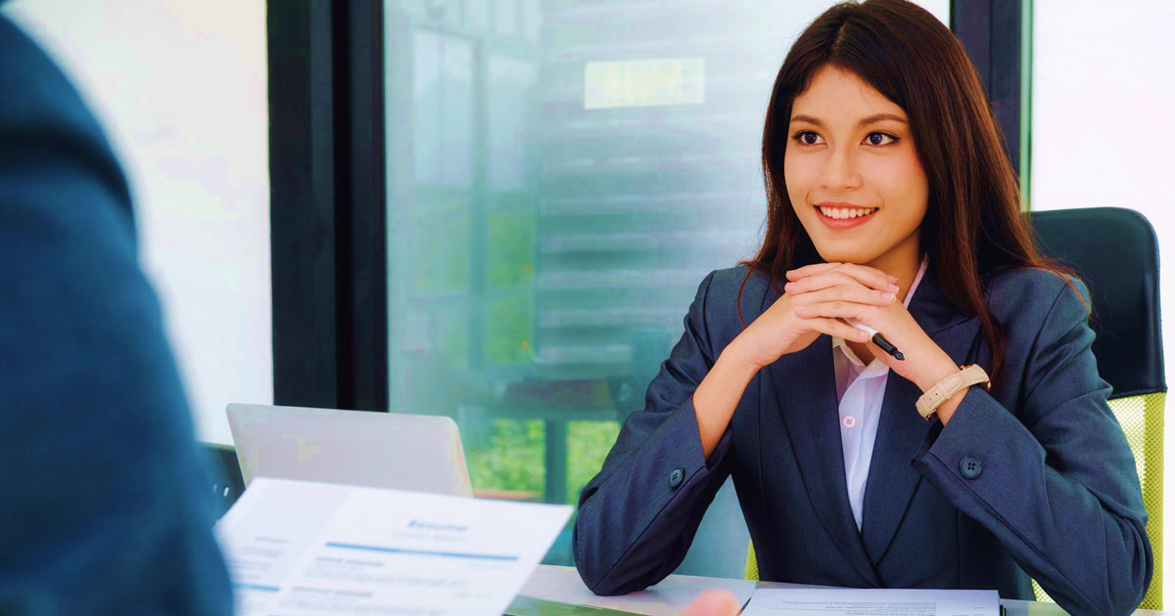
IS 3011 – Communication Skills and Professional Conduct
Sumudu Wijetunge
Dilanthi Senevirathna
Sanuri Rajapaksha
Oshadhi Jayakody

Slide 2
Lesson Objectives
By the end of the lesson, you will be able to:
Identify appropriate and inappropriate behaviors in job interviews.
Demonstrate professional body language, attire, and communication during interviews.
Practice answering common, behavioral, and hypothetical interview questions confidently.
Analyze reasons why candidates may fail interviews and suggest improvements.

Slide 3
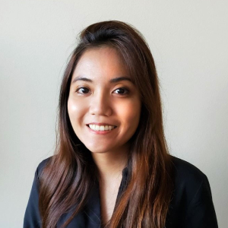

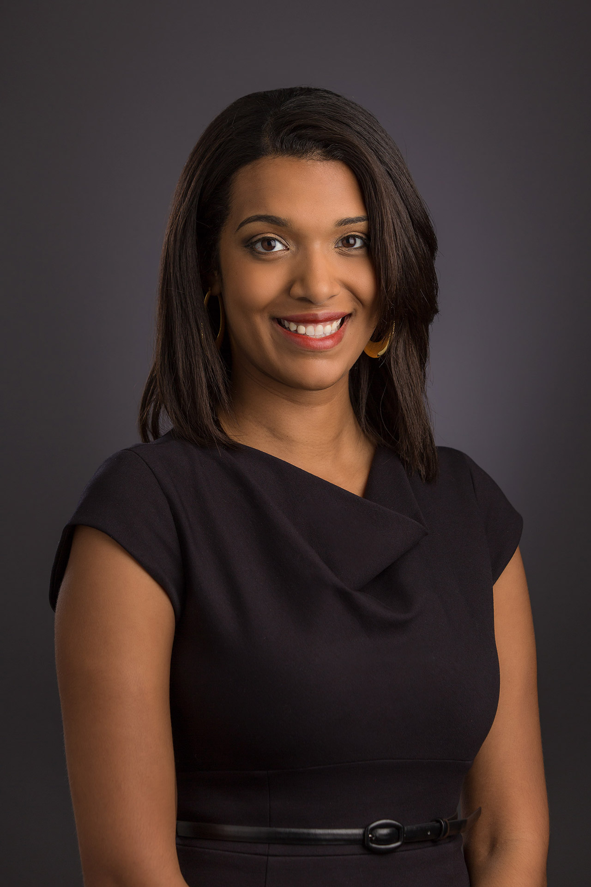
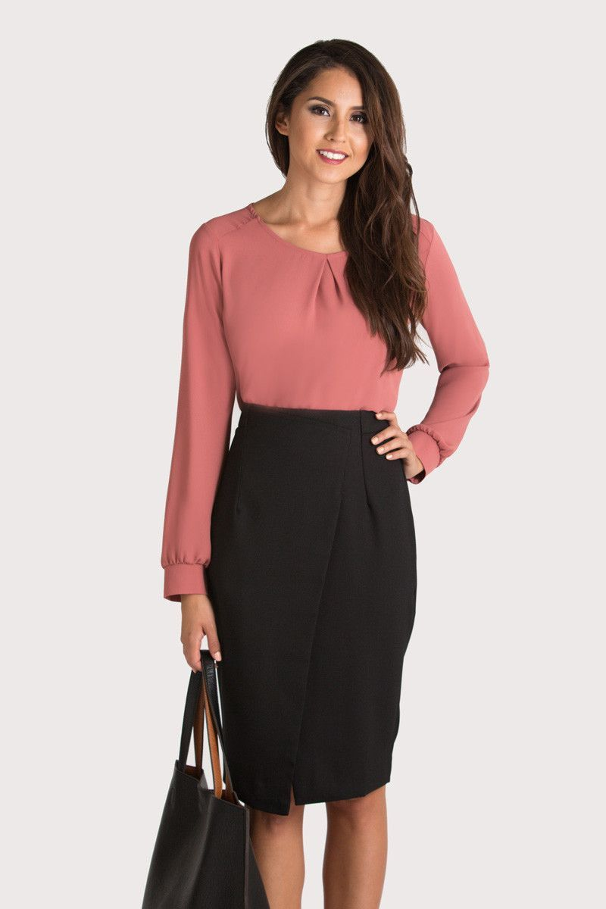
The Interview

Slide 4
Warm-up Activity
Watch the video, and list answers for the following questions:
List some of the questions the interviewers ask from the candidate.
What do you notice about the body language (facial expressions, posture & gestures, eye contact, etc.)of the candidate?
Comment on the candidate’s attire.

Slide 5
Write appropriate responses for the following commonly asked questions at interviews.
Tell us about yourself
Tell us about the projects you have done.
What are your strengths?
What are your weaknesses?
What are your career objectives 5 years from now?
Why do you think you are suitable for this job?
What motivates you?
What are the extra curricula activities you have done?
Why do you want to work for our company?
Do you have any questions for us?

Slide 6

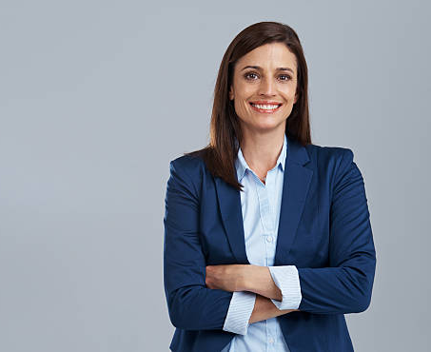
Activity 01
Given in the next slide are some behaviors observed by many interviewers. Work in small groups and separate them as “Good candidate behavior” and “Bad candidate behavior” regarding interviews onsite and virtual

Slide 7
Genuinely smiled
Informally dressed
Not well groomed
Looked interviewer in the eye
Stared at the interviewer
Was courteous to the panel of interviewers
Was rude to the receptionist
Listened well before answering
Was scared of the receptionist
Was well groomed
Wore a strong perfume
Started chatting with the other applicants while waiting to be interviewed
Took a copy of the CV to the interview
Shook hands with the interviewer
Arrived on time for the interview
Joined the interview without checking up on the technical aspects like audio quality, signal strength
Looked at the floor, ceiling and the table while answering questions.
Kept staring at the lovely picture on the wall.
Made a weakness less of a weakness by planning differently
Thanked the interviewers for the opportunity given
Good posture while sitting
Sloppy posture while sitting
Expressed ideas poorly
Asked about salary and other benefits associated with the job
Showed evidence for strengths
Showed enthusiasm in answering questions
Arrived late for the interview
Arrived late for the interview, but informed the relevant contact person of the delay

Slide 8
Answers
Bad Behaviour
Good Behaviour
Genuinely smiled
Looked interviewer in the eye
Was courteous to the panel of interviewers
Listened well before answering
Was well-groomed
Took a copy of the CV to the interview
Shook hands with the interviewer
Arrived on time for the interview
Made a weakness less of a weakness by planning differently
Thanked the interviewers for the opportunity
Good posture while sitting
Showed evidence for strengths
Showed enthusiasm in answering questions
Arrived late but informed the contact person (acceptable if unavoidable)
informally dressed
Not well-groomed
Stared at the interviewer
Was rude to the receptionist
Was scared of the receptionist
Wore a strong perfume
Started chatting with other applicants
Joined the interview without checking technical aspects (for online interviews)
Looked at the floor/ceiling/table while answering
Kept staring at the picture on the wall
Sloppy posture while sitting
Expressed ideas poorly
Asked about salary and benefits too early
Arrived late without informing

Slide 9
Tips For A Successful Job Interview
Be prepared – research
the company
the job applied for
the qualification required for the post
Look your best
Arrive early
Use appropriate body language
Use your discretion
Be enthusiastic
Be genuine
Be unique – do not highlight the things highlighted by everyone.

Slide 10
Most common reasons why people are not hired
Bad personal appearance
Unable to express self clearly
Poor interest and enthusiasm
………..
…………
Work in pairs and complete the above list.

Slide 11
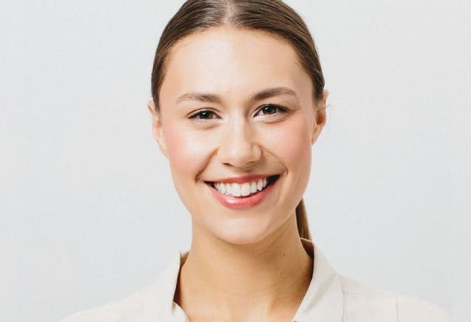
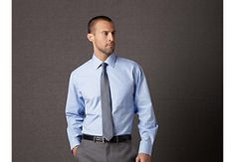
Appropriate Interview Attire
Outfit
Simple, but professional
Matching, conventional colors
Neat, clean
Matching, simple accessories

Slide 12
Tips for Successful Interviews
Rehearse before attending the actual interview
Ask for permission before you enter the room
Smile when you enter and greet the interviewers
Don’t sit until you are invited to do so.
Place your files or folders on your lap
Be cool and confident

Slide 13

Contd.
Respond clearly to questions
Be brief and to the point
Be frank
Maintain good eye contact
Thank the interviewers before leaving
Don’t be submissive or scared
Don’t stroke your fingers on anything.
Don’t bluff

Slide 14

Avoid…..
Being unprepared
Dressing inappropriately
Talking too much or not enough
Criticising previous employers or colleagues
Failing to ask questions

Slide 15
Behavioural Interview Questions – Activity 02
Tell me about a time when you had to work with a difficult teammate. How did you handle it?
Describe a situation where you faced failure. What did you learn from it?
Tell me about a time when you took the lead in a group project.
Describe a time when you had to meet a tight deadline

Slide 16
Hypothetical questions
Imagine you are given multiple urgent tasks at the same time. How would you prioritize them?
Tell me about a time when you had to work with a difficult teammate. How did you handle it?
What would you do if you realized you made a serious mistake on a project?
How would you handle a situation where you disagreed with your manager’s instructions?

Slide 17

Thank You

